Slide 1
R을 이용한 community assembly의 생태학적 분석 및 해석
김현
서울대학교 농업생명과학연구원

Slide 2
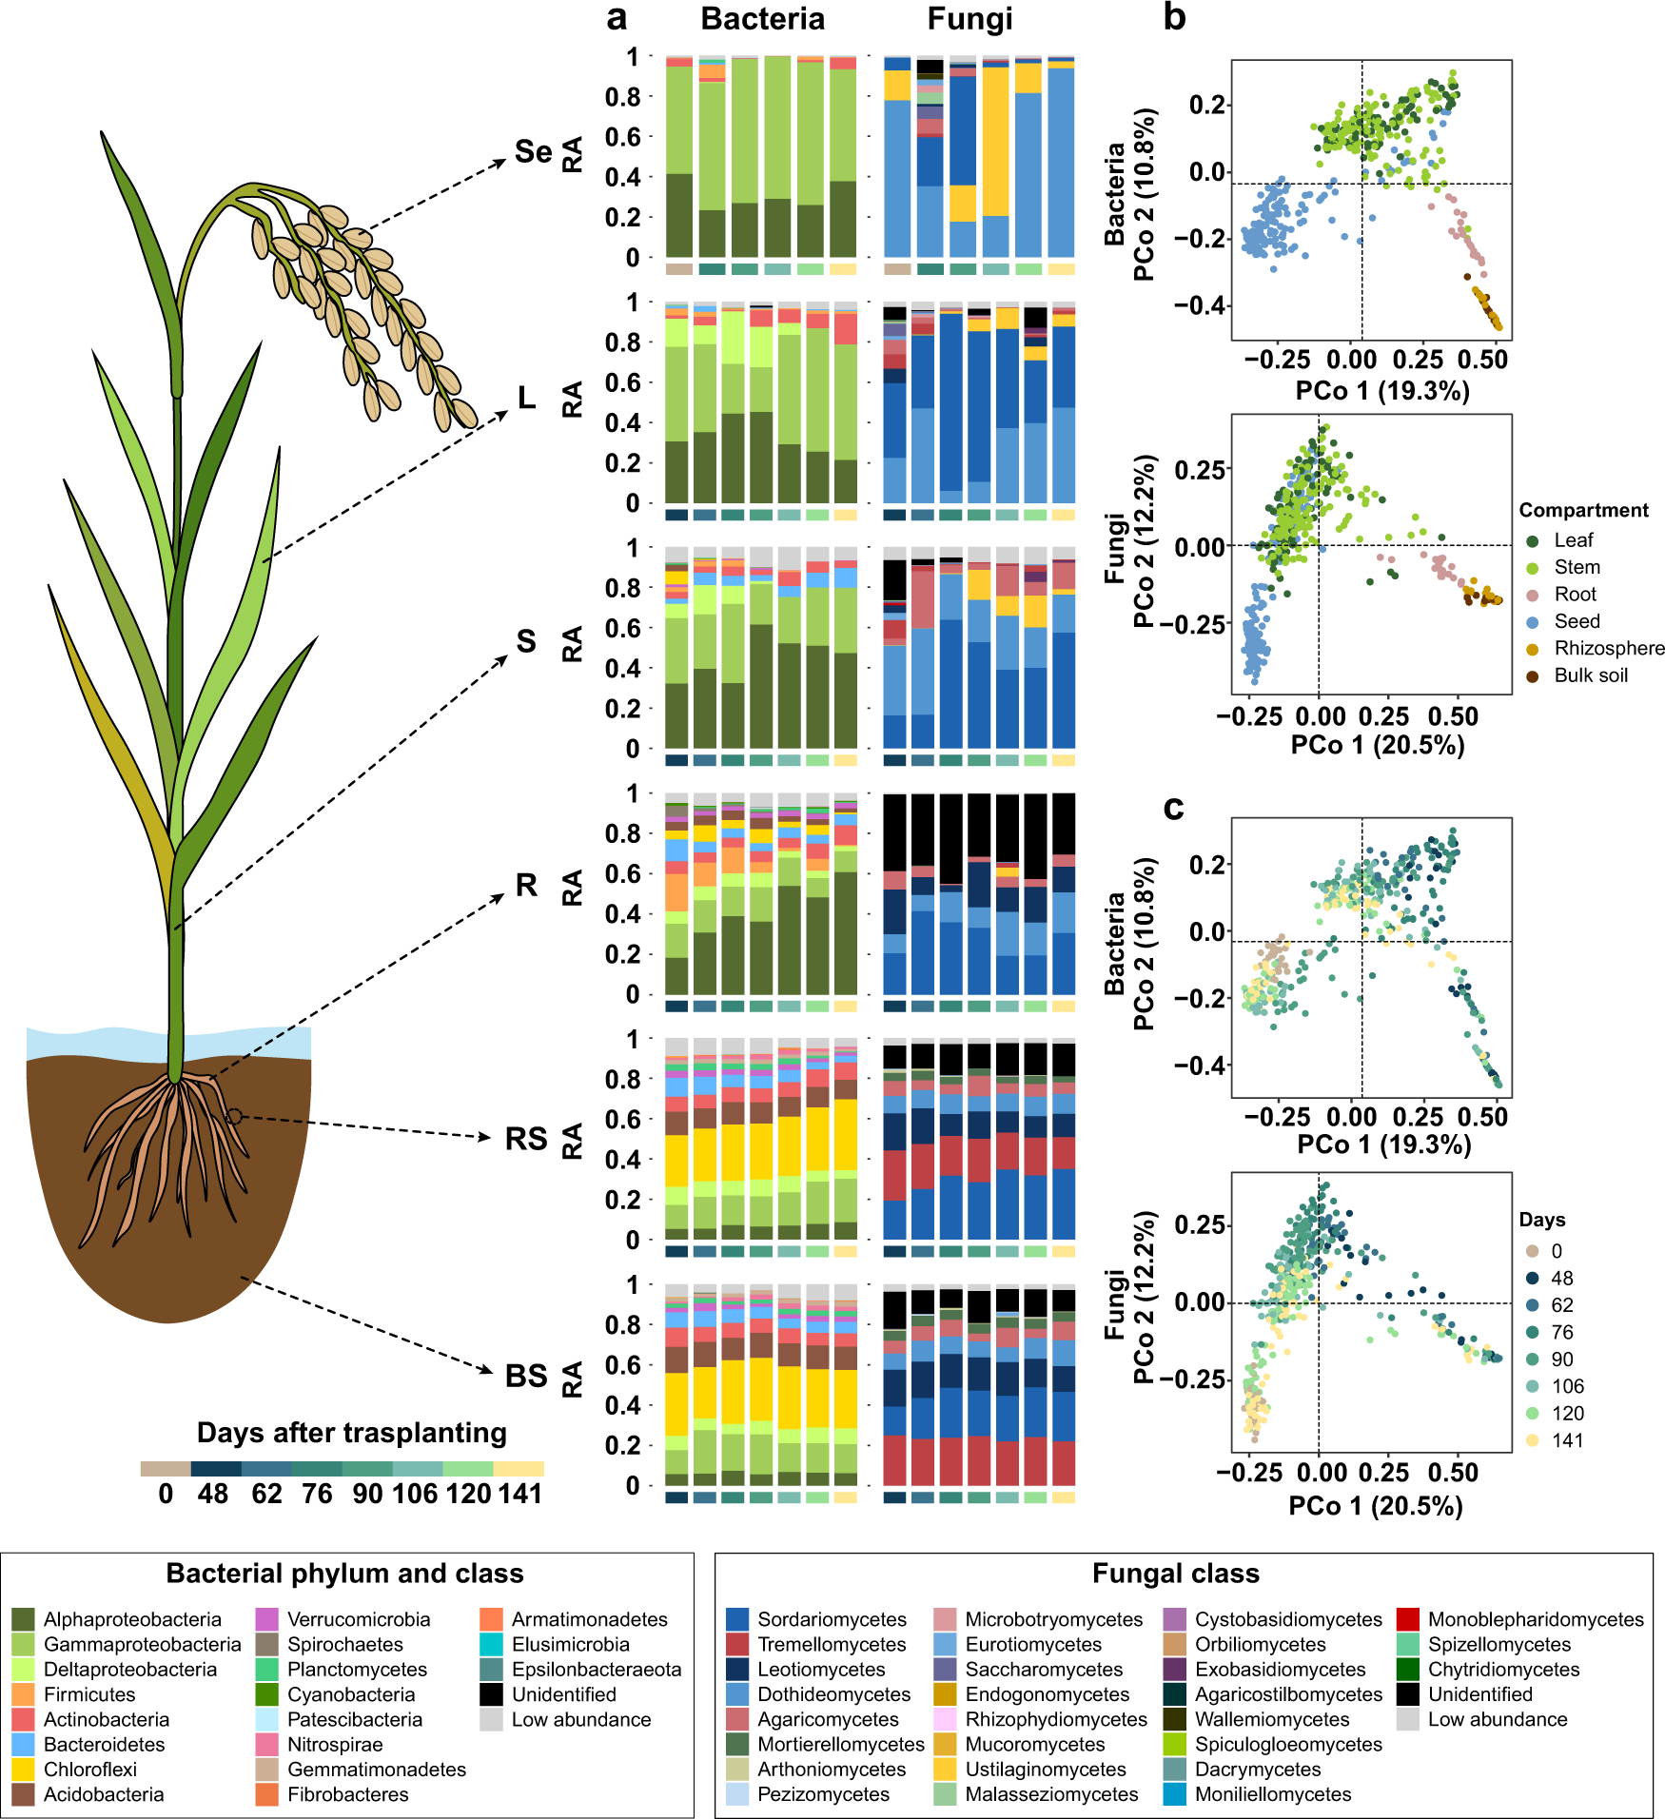
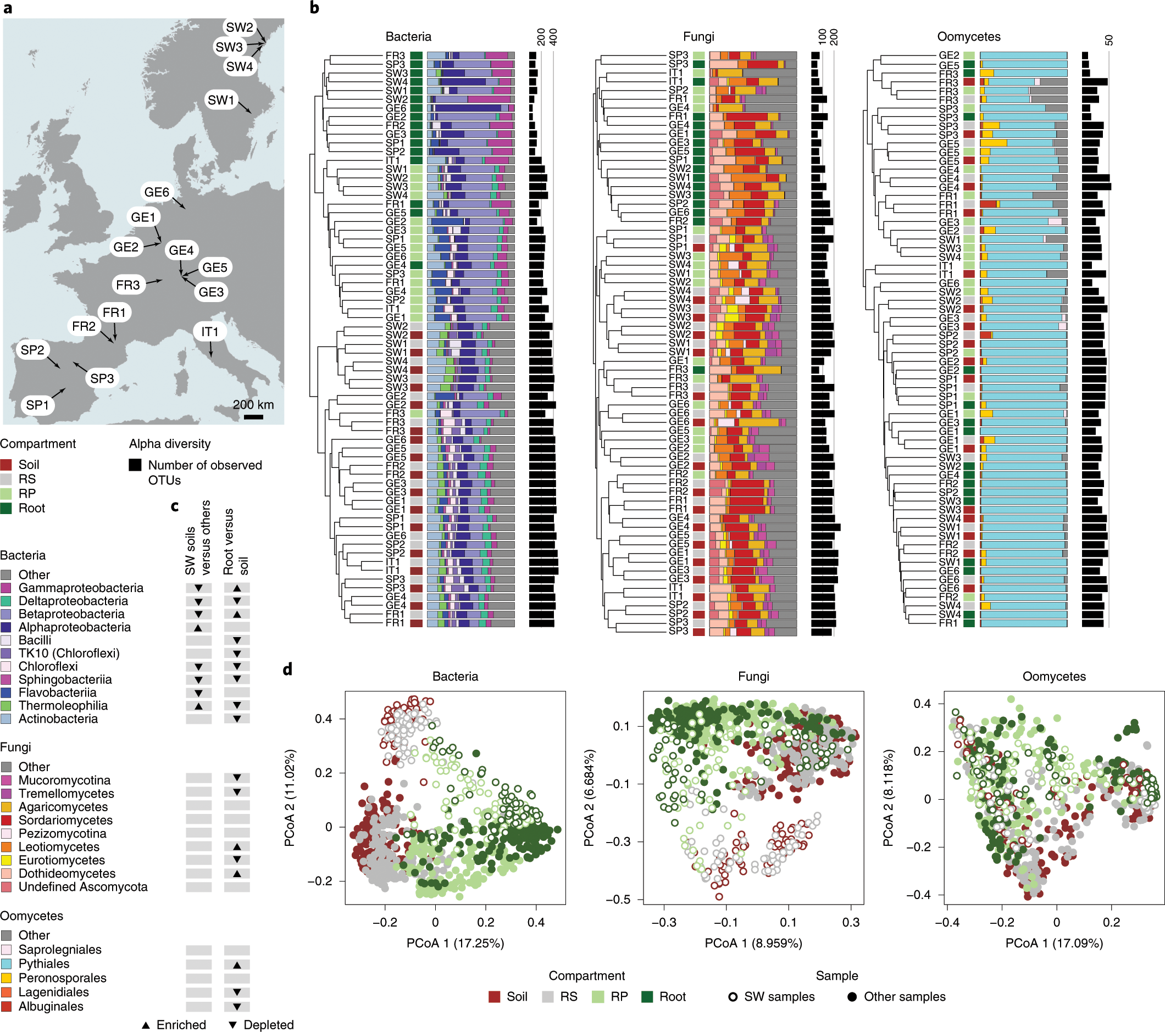
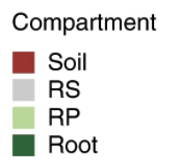
Community assembly
1
Microbial community composition varies with time and space.
Space
Time
(Thiergart et al., 2019. Nat. Ecol. Evol.)
What makes these differences and changes?
(Kim et al., 2022. Commun. Biol.)

Slide 3
Community assembly
2
The processes or mechanisms that shape the structure of ecological communities (incidence and abundance of microbes) over time and space
Microbial interaction
Dispersal
Environmental filtering
Birth, death, and reproduction

Slide 4
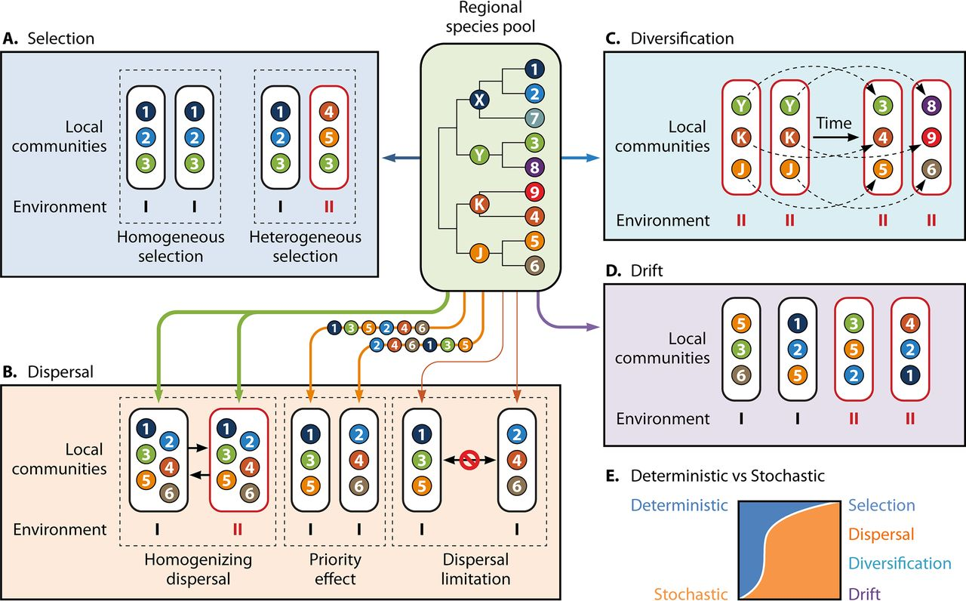
Ecological drivers (or assembly mechanisms)
3
Ecological drivers in the null model
Difference in microbial fitness
Evolutionary process
Random assembly
Microbial migration between local communities
(Zhou and Ning, 2017. Microbiol. Mol. Biol. Rev.)

Slide 5
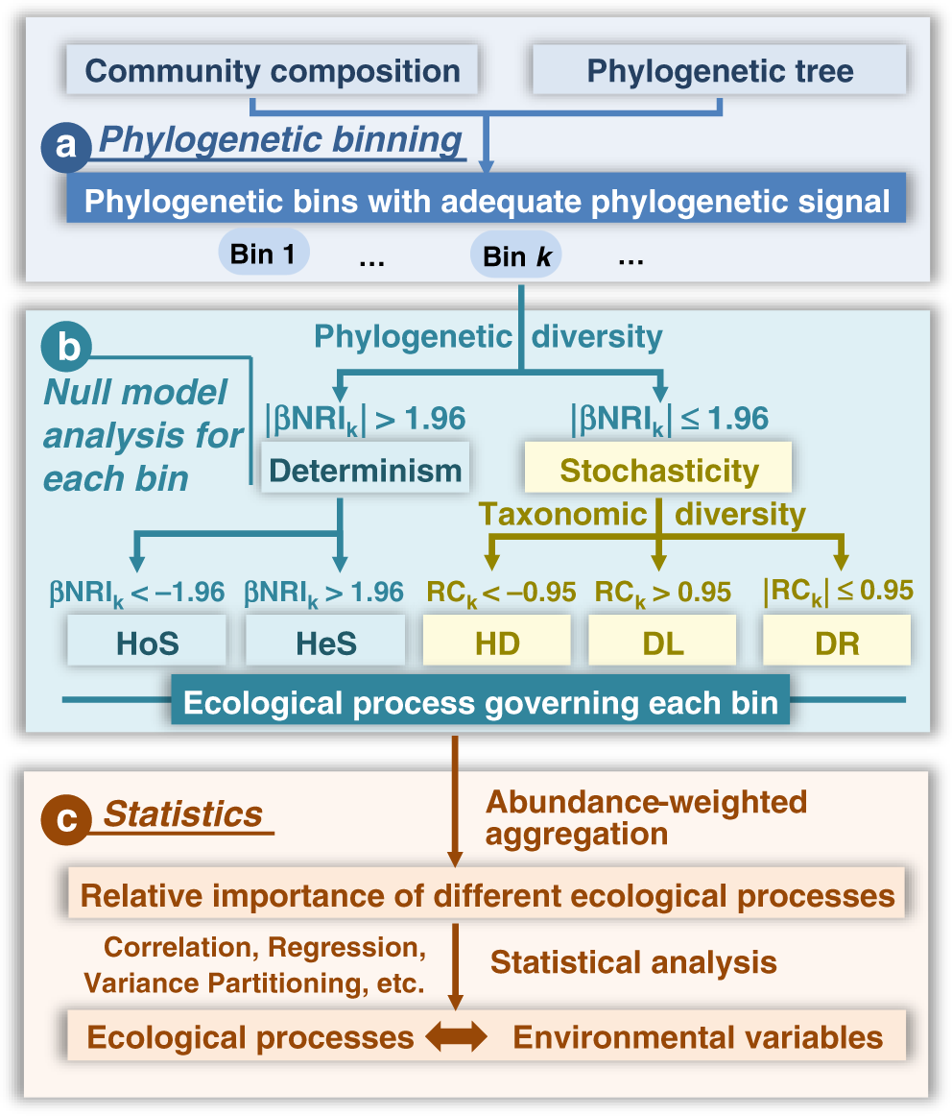
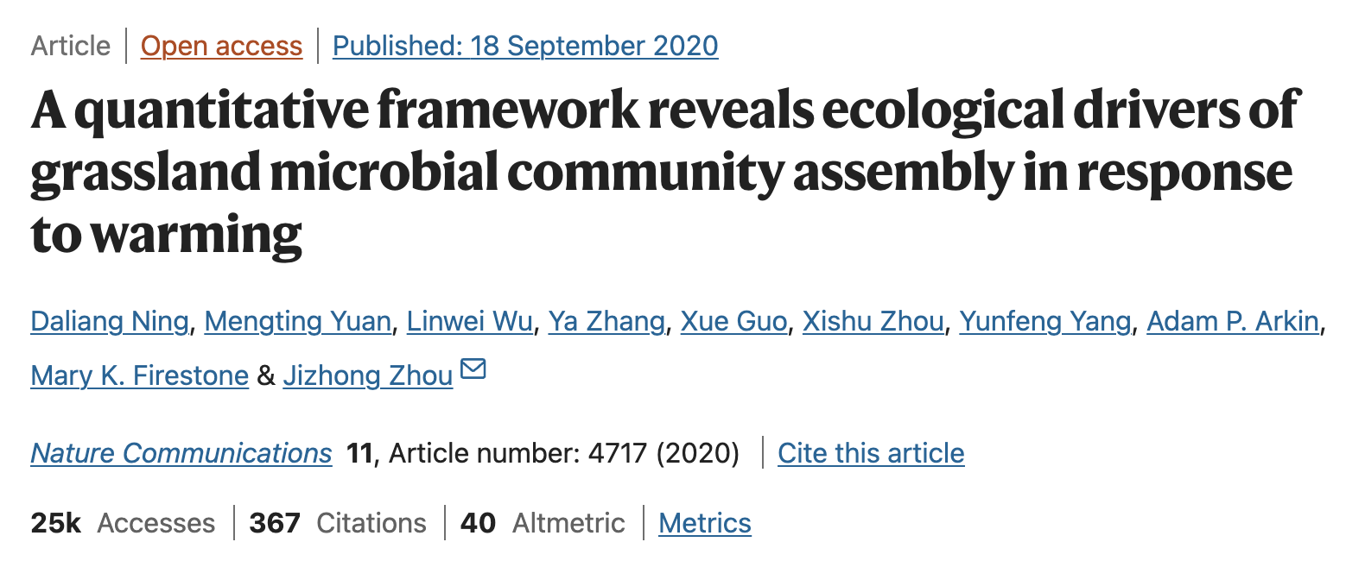
Introduction to the R package iCAMP
4
Workflow
This is the distinctiveness of the iCAMP.
The significance of ecological drivers could be predicted for each phylogenetic group.
Negative values: the observed turnover < the null expectation; low variability
Positive values: the observed turnover > the null expectation; high variability
Reference article

Slide 6
Prior to the analysis
5
Install and load required R packages
Install R packages (see 1-0)
install.packages(“reshape2”)
install.packages(“iCAMP”)
Referring to the GitHub (https://github.com/DaliangNing/iCAMP1)
install.packages(“dplyr”)
install.packages(“ape”)
install.packages(“ggplot2”)
Load R packages (see 1-1)
library(phyloseq)
library(reshape2)
library(iCAMP)
library(ape)
library(ggplot2)
library(dplyr)

Slide 7
Analysis
6
STEP 1: Load the required R packages and set variables and parameters
Variable (see 1-2)
comm: ASV or OTU abundance table (sample × ASV or OTU)
tree: Phylogenetic tree of the ASVs or OTUs
clas: Taxonomic information of ASVs
treat: Categorical data (geographic sites, plant compartments, control vs. treatment groups)
env: Continuous data (or quantitative data; soil pH, soil organic matter, and so on)
Parameter (see 1-3)
prefix: Prefix of output file names
rand.time: Randomization time
nworker: The number of thread or CPU for parallel computing
memory.G: Memory size (depending on the available disk size; unit, GB)

Slide 8
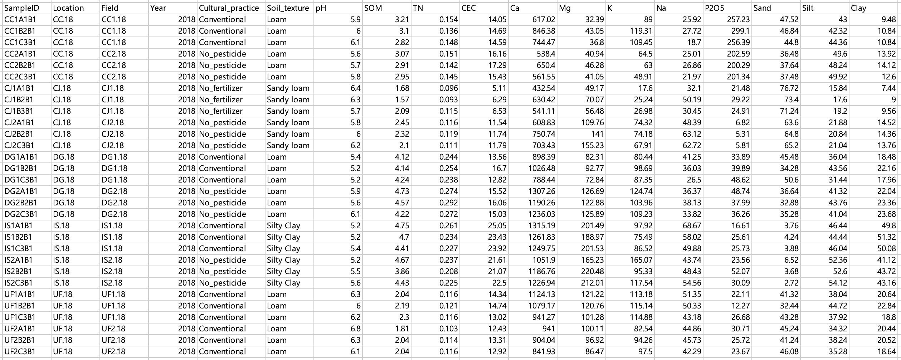
Example data for the variables treat and env
treat
env

Slide 9
Analysis
7
STEP 1: Load required R packages and set variables
Call the phyloseq object created in the previous session
load(file = “C:/Users/add.your.username/Desktop/KSPP_PhytobiomeWorkshop_2024Spring-main/Session_2/phyloseq_object.RData") # how to add a path in R script is addressed on Page 43 in this file.
Acquire variables from the previously generated phyloseq object
1. Abundance table (see 1-2-1)
comm <- data.frame(t(phyloseq::otu_table(physeq_object))) # t(): transpose (covert the position of row and column)
The reason for applying a transpose function (t)
phyloseq::otu_table(physeq_object): OTU (row) × Sample (column)
To satisfy the required format, the table needs to be transposed using the function t.

Slide 10
Analysis
8
STEP 1: Load required R packages and set variables
Acquire variables from the previously generated phyloseq object
2. Taxonomy table (see 1-2-2)
clas <- data.frame(phyloseq::tax_table(physeq_object))
3. Meta data table (see 1-2-3)
sample.metadata <- data.frame(phyloseq::sample_data(physeq_object))
treat <- sample.metadata[c(1,2,3 … ),] # export categorical data
env <- sample.metadata[c(4,5,6 … ),] # export continuous data
# * Numbers indicate the index of columns.
4. Phylogenetic tree (see 1-2-4)
tree <- phyloseq::phy_tree(physeq_object)

Slide 11
Analysis
9
STEP 2: Check data
Check sample IDs in the prepared variables (see 2-1)
1-1. When the env variable is available
sampid.check=match.name(rn.list=list(comm=comm,treat=treat,env=env))
1-2. When the env variable is not available (we will use it at this time.)
sampid.check=match.name(rn.list=list(comm=comm,treat=treat))
The output should be “All match very well”.
2. Acquire values with consistent sample IDs
treat=sampid.check$treat
comm=sampid.check$comm
comm=comm[,colSums(comm)>0,drop=FALSE] # if some unmatched samples were removed, some ASVs may become ghosts, then you may use this line to remove them if necessary.
env=sampid.check$env # skip this if you do not have an env file

Slide 12
Analysis
10
STEP 2: Check data
Check ASV or OTU IDs in the prepared variables (see 2-2)
1. Check ASV or OTU IDs
spid.check=match.name(cn.list=list(comm=comm),rn.list=list(clas=clas),
tree.list=list(tree=tree))
The output should be “All match very well”.
2. Acquire values with consistent ASV or OTU IDs
comm=spid.check$comm
clas=spid.check$clas
tree=spid.check$tree

Slide 13
Analysis
11
STEP 3: Get pairwise phylogenetic distance matrix
1. Set the directory where results will be saved (see 3-1)
save.wd <- “path/to/your/directory/Output” # add your own path
setwd(save.wd)
2. Calculate pairwise phylogenetic distance (see 3-2)
if(!file.exists("pd.desc"))
{
pd.big=iCAMP::pdist.big(tree = tree, wd=save.wd, nworker = nworker, memory.G = memory.G)
}else{
# if you already calculated the phylogenetic distance matrix in a previous run
pd.big=list()
pd.big$tip.label=read.csv(paste0(save.wd,"/pd.taxon.name.csv"),row.names = 1,stringsAsFactors = FALSE)[,1]
pd.big$pd.wd=save.wd
pd.big$pd.file="pd.desc"
pd.big$pd.name.file="pd.taxon.name.csv"
}

Slide 14
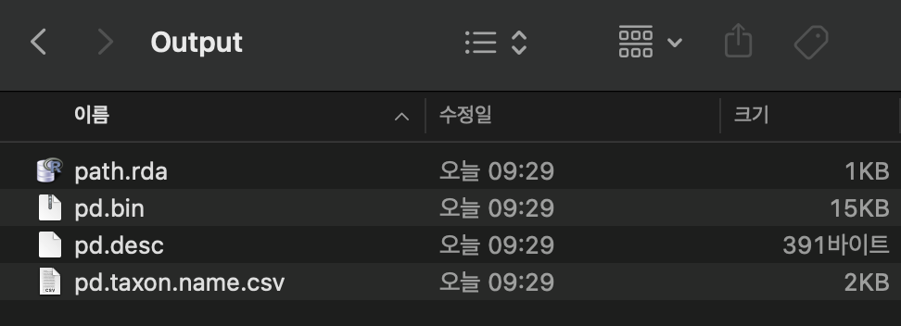
Analysis
12
STEP 3: Get pairwise phylogenetic distance matrix
A total of four files should be created in your directory (in save.wd).
path.rda: an R object to list all the nodes and edge lengths from root to every tip. Saved in R data format. An intermediate output when calculating the phylogenetic distance matrix.
pd.bin: BIN file (backing file) generated by function big.matrix in R package bigmemory. This is the big matrix storing pairwise phylogenetic distance values.
By using this bigmemory format file, we will not need memory but a hard disk when calling big matrix for calculation.
pd.desc: the DESC file (descriptor file) to hold the backing file (pd.bin) description.
pd.taxon.name.csv: a comma-delimited CSV file storing the IDs of tree tips (ASVs or OTUs), serving as the row/column names of the big phylogenetic distance matrix.

Slide 15
Analysis
13
STEP 4: Run the iCAMP analysis
Since env object is not available at this time, we will skip the section 4-1.
Let’s move to the section 4-2.
bin.size.limit = 5 # To decide the adequate bin size, the phylogenetic signal test in the auxiliary script could be performed.
sig.index="Confidence"
icres=iCAMP::icamp.big(comm=comm, pd.desc = pd.big$pd.file, pd.spname=pd.big$tip.label,
pd.wd = pd.big$pd.wd, rand = rand.time, tree=tree,
prefix = prefix, ds = 0.2, pd.cut = NA, sp.check = TRUE,
phylo.rand.scale = "within.bin", taxa.rand.scale = "across.all",
phylo.metric = "bMPD", sig.index=sig.index, bin.size.limit = bin.size.limit,
nworker = nworker, memory.G = memory.G, rtree.save = FALSE, detail.save = TRUE, qp.save = FALSE, detail.null = FALSE, ignore.zero = TRUE, output.wd = save.wd, correct.special = TRUE, unit.sum = rowSums(comm), special.method = "depend", ses.cut = 1.96, rc.cut = 0.95, conf.cut=0.975, omit.option = "no",meta.ab = NULL)
Please refer to the document available in the “Help” tab for details on the parameters of the function icamp.big.

Slide 16
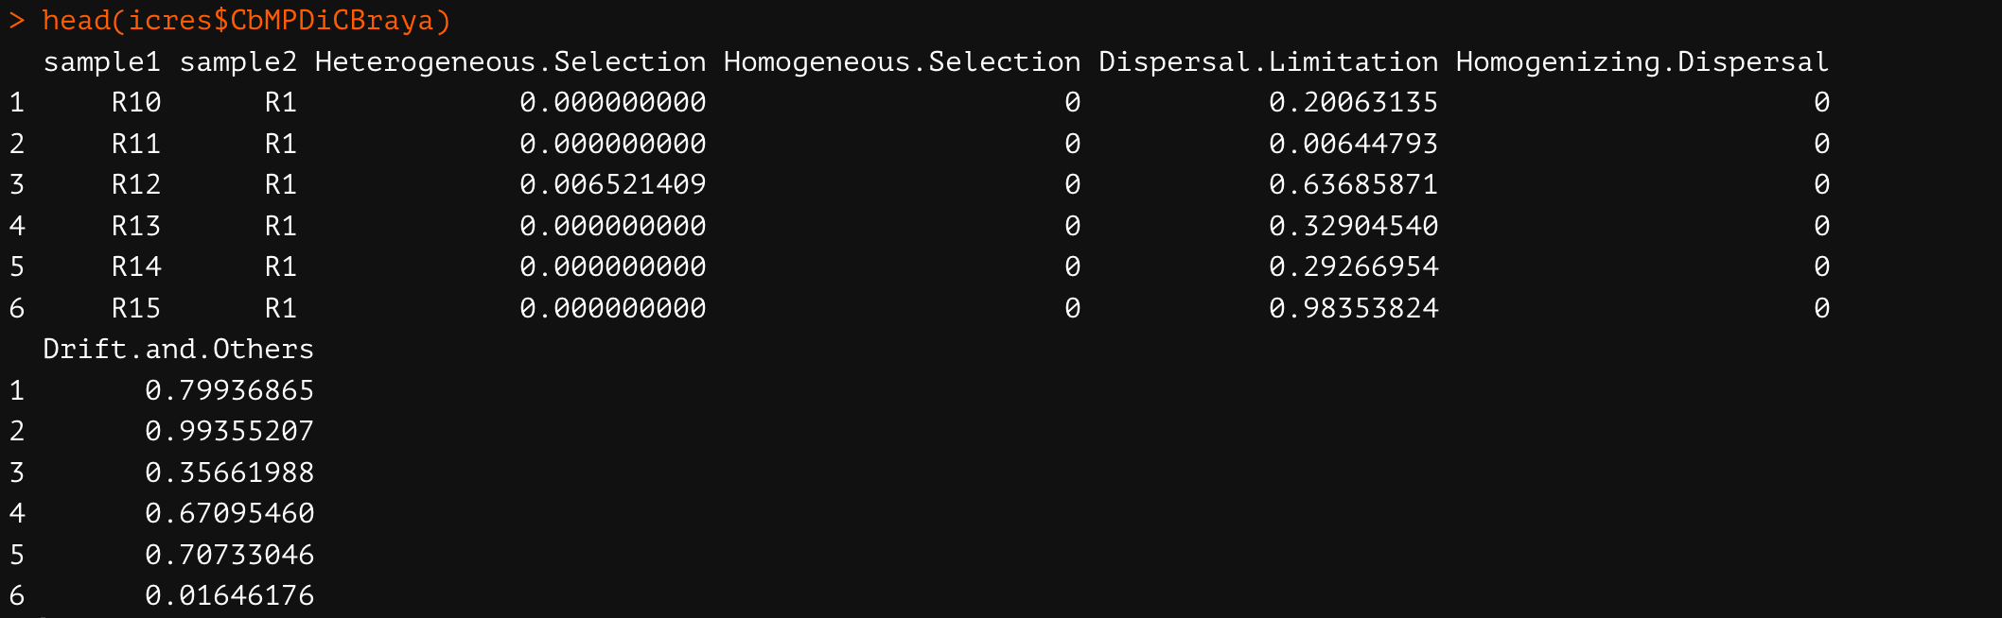
Analysis
14
STEP 4: Run the iCAMP analysis
Output
head(icres$CbMPDiCBraya)
The relative importance of ecological drivers at the sample level is available.

Slide 17
Analysis
15
STEP 5: Parse the iCAMP results for further analyses (see 5)
Calculate various statistic index to assess relative importance of each process in each bin and each turnover, and bin's contribution to each process.
icbin=icamp.bins(icamp.detail = icres$detail,treat = treat, clas=clas,silent=FALSE, boot = TRUE, rand.time = rand.time, between.group = TRUE)
save(icbin,file = paste0(prefix,".iCAMP.Summary.rda"))
write.csv(icbin$Pt,file = paste0(prefix,".ProcessImportance_EachGroup.csv"),row.names = FALSE)
write.csv(icbin$Ptk,file = paste0(prefix,".ProcessImportance_EachBin_EachGroup.csv"),row.names = FALSE)
write.csv(icbin$Ptuv,file = paste0(prefix,".ProcessImportance_EachTurnover.csv"),row.names = FALSE)
write.csv(icbin$BPtk,file = paste0(prefix,".BinContributeToProcess_EachGroup.csv"),row.names = FALSE)
write.csv(data.frame(ID=rownames(icbin$Class.Bin),icbin$Class.Bin,stringsAsFactors = FALSE), file = paste0(prefix,".Taxon_Bin.csv"),row.names = FALSE)
write.csv(icbin$Bin.TopClass,file = paste0(prefix,".Bin_TopTaxon.csv"),row.names = FALSE)

Slide 18
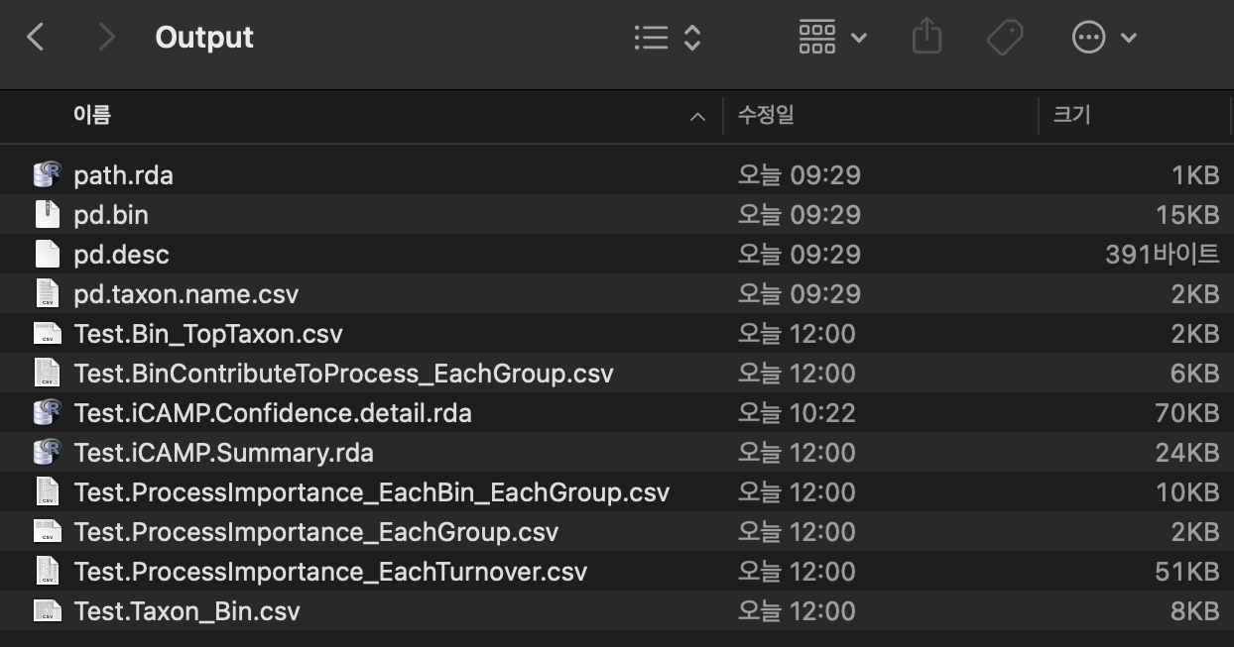
Analysis
16
STEP 5: Parse the iCAMP results for further analyses
A total of eight files should be created in your directory (in save.wd).

Slide 19
Analysis
17
STEP 5: Parse the iCAMP results for further analyses
Descriptions of output files
Test.iCAMP.Summary.rda: the object "icbin" saved in R data format. see help document of the function icamp.bins for description of each element in the object.
Test.ProcessImportance_EachGroup.csv: Relative importance of each process in governing the turnovers (compositional change; each sample) in a group of samples.
Test.ProcessImportance_EachBin_EachGroup.csv: Relative importance of each process in governing the turnovers of each bin among a group of samples.
Test.ProcessImportance_EachTurnover.csv: Relative importance of each process in governing the turnovers between each pair of communities (samples).
Test.BinContributeToProcess_EachGroup.csv: Bin contribution to each process, measuring the contribution of each bin to the relative importance of each process in the assembly of a group of communities.
Test.Taxon_Bin.csv: a matrix showing the bin ID and classification information for each taxon.
Test.Bin_TopTaxon.csv: a matrix showing the bin relative abundance; the top taxon ID, percentage in bin, and classification; the most abundant name at each phylogeny level in the bin.
The visualization of results could be done using the above files.

Slide 20
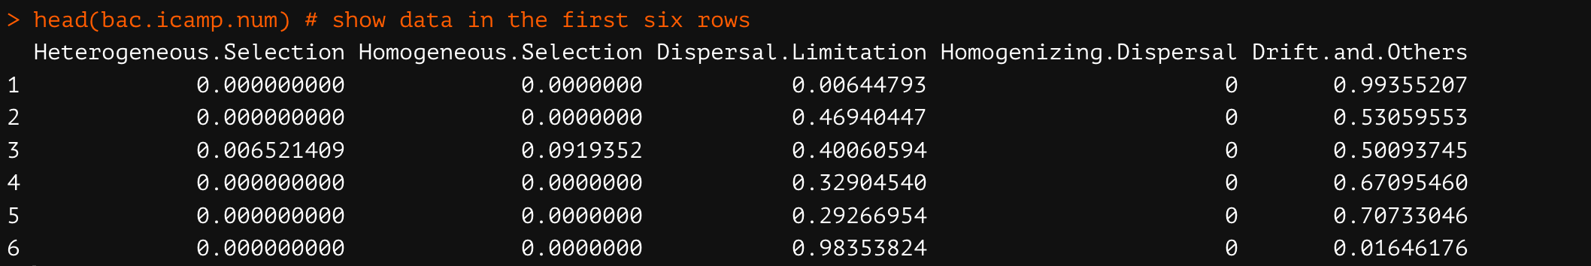
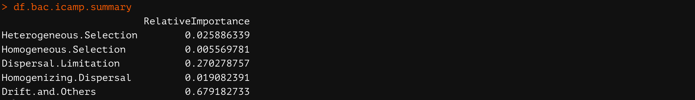
Visualization
18
Community level (see 6-1)
1. Summarize the ICAMP result (see 6-1-1)
bac.icamp <- icres$CbMPDiCBraya #bac.icamp <- read.csv("Test.ProcessImportance_EachTurnover.csv") # identical to the above
bac.icamp.num <- bac.icamp[-c(1,2)]
head(bac.icamp.num)
bac.icamp.summary <- colMeans(bac.icamp.num)
df.bac.icamp.summary <- data.frame(bac.icamp.summary)
names(df.bac.icamp.summary)[1] <- "RelativeImportance"
df.bac.icamp.summary

Slide 21
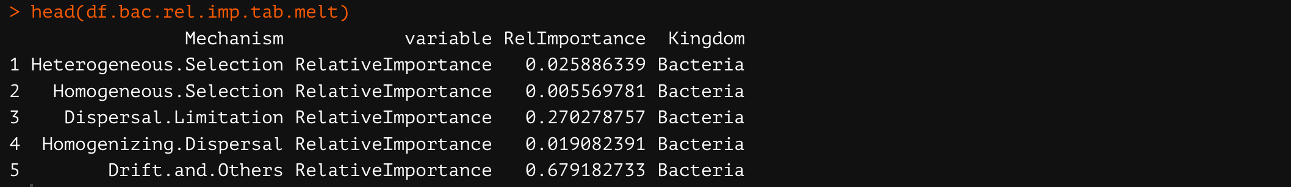
Visualization
19
Community level
2. Melt a data frame (make a long data frame object) (see 6-1-2)
bac.icamp.summary$Mechanism <- rownames(bac.icamp.summary)
df.bac.rel.imp.tab.melt <- reshape2::melt(bac.icamp.summary)
colnames(df.bac.rel.imp.tab.melt) # “Mechanism” “variable” “value”
names(df.bac.rel.imp.tab.melt)[3] <- "RelImportance"
df.bac.rel.imp.tab.melt$Kingdom <- "Bacteria”
df.bac.rel.imp.tab.melt$Mechanism <- factor(df.bac.rel.imp.tab.melt$Mechanism, levels = rev(c("Homogeneous.Selection","Heterogeneous.Selection", "Dispersal.Limitation", "Homogenizing.Dispersal", "Drift.and.Others")))
head(df.bac.rel.imp.tab.melt)
The data for the visualization was prepared.

Slide 22
Visualization
20
Community level
3. Make a plot (see 6-1-3)
ggplot(df.bac.rel.imp.tab.melt, aes(x=Kingdom, y = RelImportance, fill = Mechanism)) +
geom_bar(stat="identity", width = 0.8, position = 'stack') +
scale_fill_manual(values = c("Homogeneous.Selection"="#3c93c2", "Heterogeneous.Selection" = "#9ec9e2", "Dispersal.Limitation" = "#fcde9c", "Homogenizing.Dispersal" = "#feb24c", "Drift.and.Others"="#fc4e2a")) +
xlab('')+ theme(aspect.ratio = 2) + ylab("Relative importance \n") + guides(fill = guide_legend(nrow = 5,reverse = F))+
theme(legend.position="right") +
theme(plot.title = element_text(size = 20,hjust = 0.5, face='bold')) +
theme(axis.title.x = element_text(size = 15,hjust = 0.5, face='bold')) +
theme(axis.title.y = element_text(size = 13,hjust = 0.5, face='bold')) +
theme(axis.text.x = element_text(angle = 0, hjust = 0.5, vjust=0.4,size=12, face='bold',color='black'))+
theme(axis.text.y = element_text(size=15, face='bold',color='black'))+
scale_y_continuous(breaks=seq(0,1,0.2))+
theme(panel.grid.major = element_blank()) + theme(panel.grid.minor = element_blank(), panel.background=element_blank(),panel.border=element_blank(), plot.background=element_blank())

Slide 23
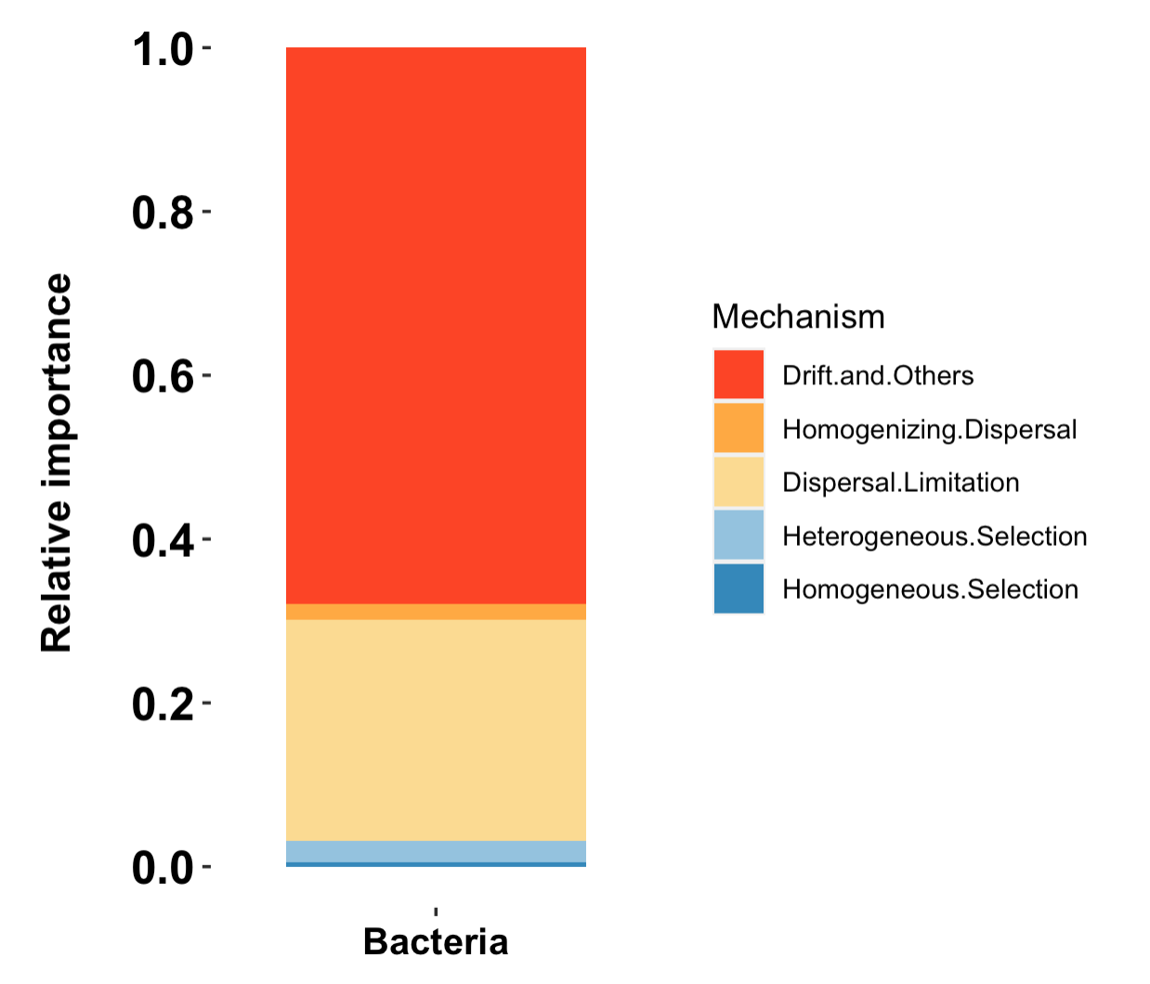
Figure 1
21

Slide 24
Welcome any questions
Please contact kh0219@snu.ac.kr

Slide 25
Auxiliary visualization script:
From data tables to graphs

Slide 26
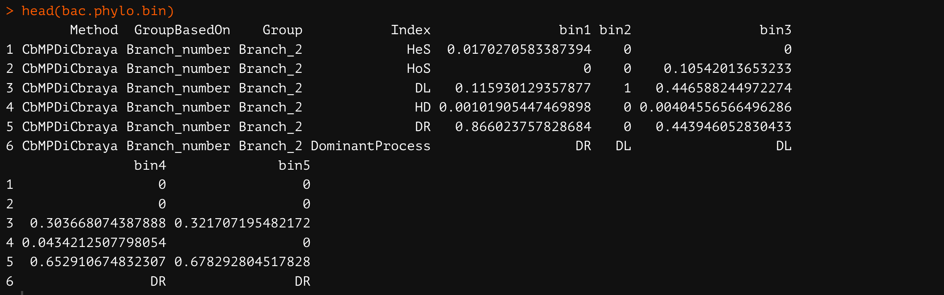
Visualization
1
Phylogenetic bin level (see 6-2)
1. Parse data from the result(see 6-2-1)
bac.phylo.bin<-read.csv("Test.ProcessImportance_EachBin_EachGroup.csv")
head(bac.phylo.bin)
bac.phylo.bin <- bac.phylo.bin[-c(1,2)] # remove the first and second column
bac.phylo.bin <- subset(bac.phylo.bin, !(rownames(bac.phylo.bin) %in% rownames(bac.phylo.bin[grep("DominantProcess",bac.phylo.bin$Index),]))) # remove rows containing the value DominantProcess in the column Index
Non-numeric values should be removed.

Slide 27
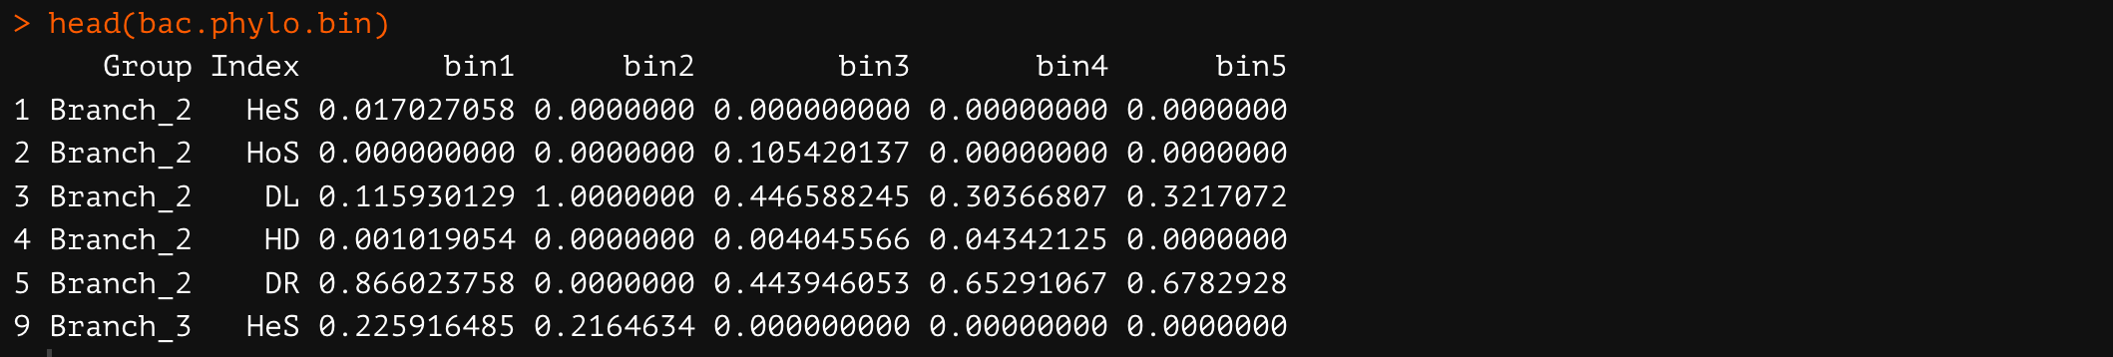
Visualization
2
Phylogenetic bin level (see 6-2)
1. Parse data from the result(see 6-2-1)
### Change the class type if the class of the remaining values is the character
i<-c(3:ncol(bac.phylo.bin))
bac.phylo.bin[, i] <- apply(bac.phylo.bin[ , i], 2,function(x) as.numeric(as.character(x)))
head(bac.phylo.bin)

Slide 28
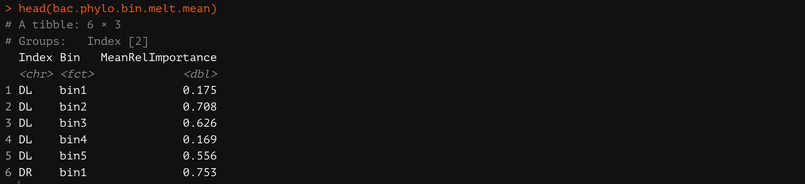
Visualization
3
Phylogenetic bin level
2. Melt a data frame (make a long data frame object) (see 6-2-2)
bac.phylo.bin.melt <- reshape2::melt(bac.phylo.bin)
subset(bac.phylo.bin.melt, value == "NaN") ### check if there is "NaN" among values
bac.phylo.bin.melt<-subset(bac.phylo.bin.melt, value != "NaN") ### remove "NaN" when it exists
bac.phylo.bin.melt.mean <- bac.phylo.bin.melt %>% group_by(Index, variable) %>% summarise(MeanRelImportance = mean(value))
names(bac.phylo.bin.melt.mean)[2] <- "Bin"
head(bac.phylo.bin.melt.mean)

Slide 29
Visualization
4
Phylogenetic bin level
2. Melt a data frame (make a long data frame object) (see 6-2-2)
### Arrange the values prior to plotting
bac.phylo.bin.melt.mean$Bin <- factor(bac.phylo.bin.melt.mean$Bin, levels = c("bin1","bin2","bin3","bin4","bin5"))
bac.phylo.bin.melt.mean$Index <- factor(bac.phylo.bin.melt.mean$Index, levels = rev(c("HoS","HeS","DL","HD","DR")))

Slide 30
Visualization
5
Phylogenetic bin level
3. Make a plot (see 6-2-3)
ggplot(bac.phylo.bin.melt.mean, aes(x=Bin, y = MeanRelImportance, fill = Index)) +
geom_bar(stat="identity", width = 0.8, position = 'stack') +
#scale_fill_discrete() +
scale_fill_manual(values = c("HoS"= "#3c93c2","HeS" = "#9ec9e2", "DL" = "#fcde9c", "HD" = "#feb24c",
"DR"="#fc4e2a")) +
xlab('')+ theme(aspect.ratio = 1) + ylab("Relative importance \n") +
## adjust positions
guides(fill = guide_legend(nrow = 5,reverse = F))+
theme(legend.position="right") +
theme(plot.title = element_text(size = 20,hjust = 0.5, face='bold')) +
theme(axis.title.x = element_text(size = 15,hjust = 0.5, face='bold')) +
theme(axis.title.y = element_text(size = 13,hjust = 0.5, face='bold')) +
theme(axis.text.x = element_text(angle = 90, hjust = 0.5, vjust=0.4,size=12, face='bold',color='black'))+
theme(axis.text.y = element_text(size=15, face='bold',color='black'))+
scale_y_continuous(breaks=seq(0,1,0.2))+
theme(panel.grid.major = element_blank()) +
theme(panel.grid.minor = element_blank(), panel.background=element_blank(),panel.border=element_blank(), plot.background=element_blank())

Slide 31
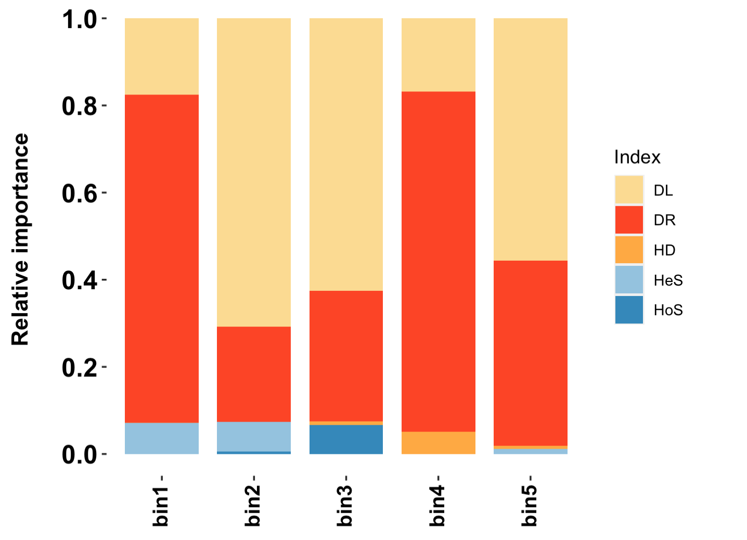
Figure 2
6

Slide 32
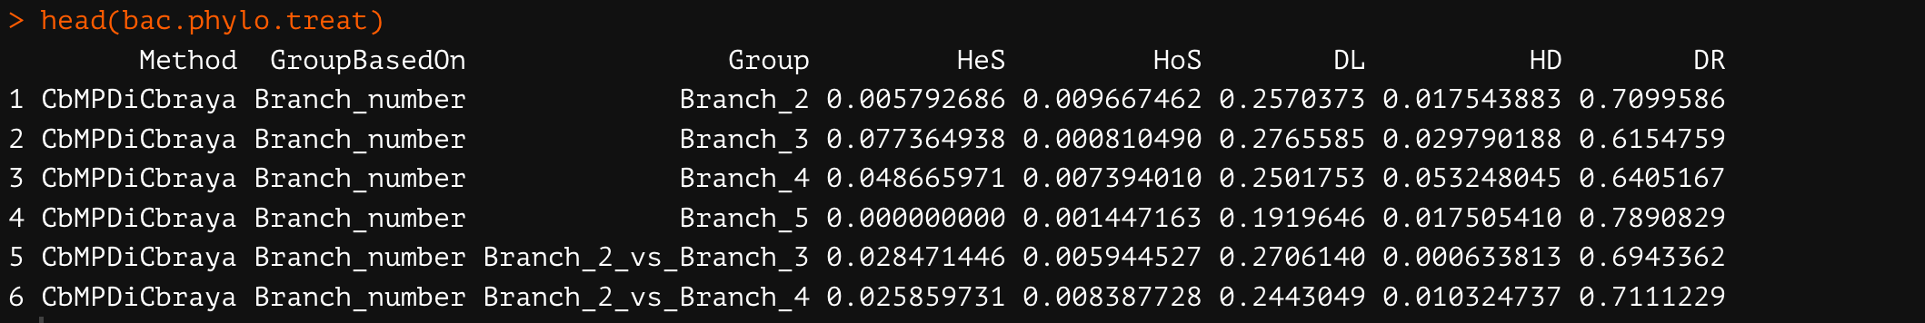
Visualization
7
Ecological drivers of treatment groups (see 6-3)
1. Parse data from the result(see 6-3-1)
bac.phylo.treat<-read.csv("Test.ProcessImportance_EachGroup.csv")
head(bac.phylo.treat)

Slide 33
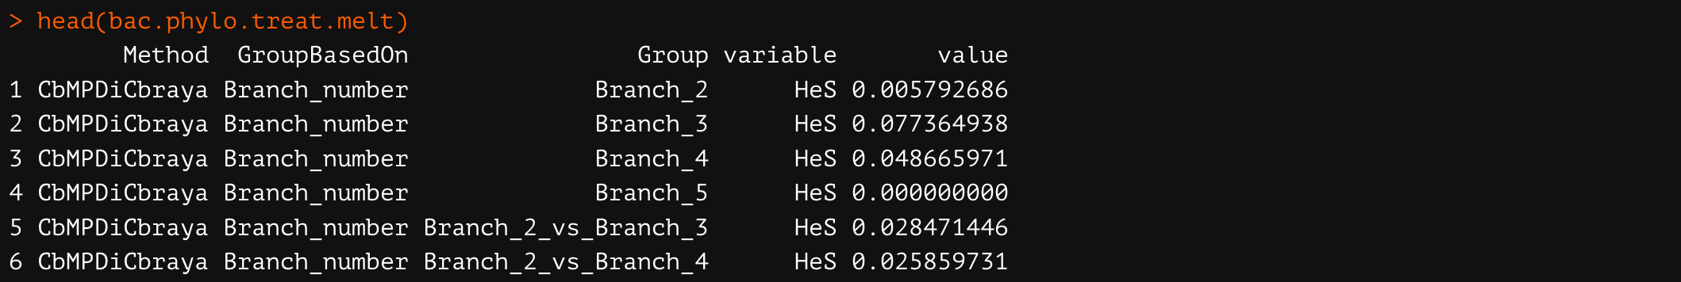
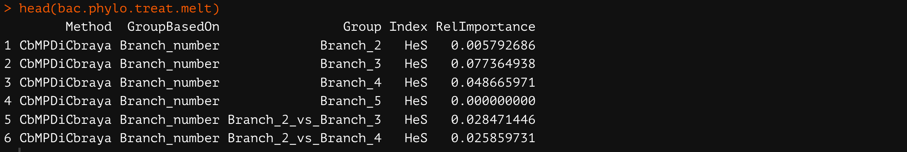
Visualization
8
Ecological drivers of treatment groups
2. Melt a data frame (make a long data frame object) (see 6-3-2)
bac.phylo.treat.melt <- reshape2::melt(bac.phylo.treat)
head(bac.phylo.treat.melt)
names(bac.phylo.treat.melt)[4] <- "Index"
names(bac.phylo.treat.melt)[5] <- "RelImportance"

Slide 34
Visualization
9
Ecological drivers of treatment groups
2. Melt a data frame (make a long data frame object) (see 6-3-2)
### Arrange the values prior to plotting
bac.phylo.treat.melt$Index <- factor(bac.phylo.treat.melt$Index, levels = rev(c("HoS","HeS","DL","HD","DR")))
group.list<-unique(bac.phylo.treat.melt$Group)
group.list
bac.phylo.treat.melt$Group <- factor(bac.phylo.treat.melt$Group, levels = group.list)

Slide 35
Visualization
10
Ecological drivers of treatment groups
3. Make a plot (see 6-3-3)
ggplot(bac.phylo.treat.melt, aes(x=Group, y = RelImportance, fill = Index)) +
geom_bar(stat="identity", width = 0.8, position = 'stack') +
scale_fill_manual(values = c("HoS"= "#3c93c2","HeS" = "#9ec9e2",
"DL" = "#fcde9c", "HD" = "#feb24c",
"DR"="#fc4e2a")) +
xlab('')+ theme(aspect.ratio = 1) +
ylab("Relative importance \n") +
guides(fill = guide_legend(nrow = 5,reverse = F))+
theme(legend.position="right") +
theme(plot.title = element_text(size = 20,hjust = 0.5, face='bold')) +
theme(axis.title.x = element_text(size = 15,hjust = 0.5, face='bold')) +
theme(axis.title.y = element_text(size = 13,hjust = 0.5, face='bold')) +
theme(axis.text.x = element_text(angle = 90, hjust = 1, vjust=0.4,size=12, face='bold',color='black'))+
theme(axis.text.y = element_text(size=15, face='bold',color='black'))+
scale_y_continuous(breaks=seq(0,1,0.2))+
theme(panel.grid.major = element_blank()) +
theme(panel.grid.minor = element_blank(), panel.background=element_blank(),panel.border=element_blank(), plot.background=element_blank())

Slide 36
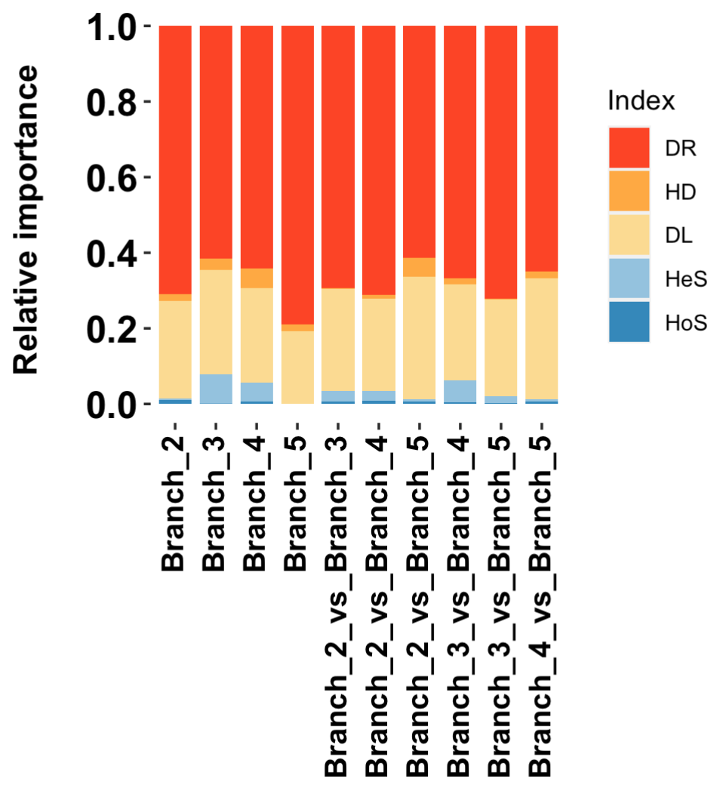
Further application
11

Slide 37
Visualization
12
Ecological drivers of treatment groups and each bin (see 6-4)
1. Parse data from the result (see 6-4-1)
bac.phylo.bin<-read.csv("Test.ProcessImportance_EachBin_EachGroup.csv")
bac.phylo.bin <- bac.phylo.bin[-c(1,2)]
# remove the first and second column
bac.phylo.bin <- subset(bac.phylo.bin, !(rownames(bac.phylo.bin) %in%
rownames(bac.phylo.bin[grep("DominantProcess",bac.phylo.bin$Index),])))
# remove rows containing the value DominantProcess in the column Index
### change the class to numeric if the class of relative importance values is character
i<-c(3:ncol(bac.phylo.bin))
bac.phylo.bin[, i] <- apply(bac.phylo.bin[ , i], 2,function(x) as.numeric(as.character(x)))
head(bac.phylo.bin)

Slide 38
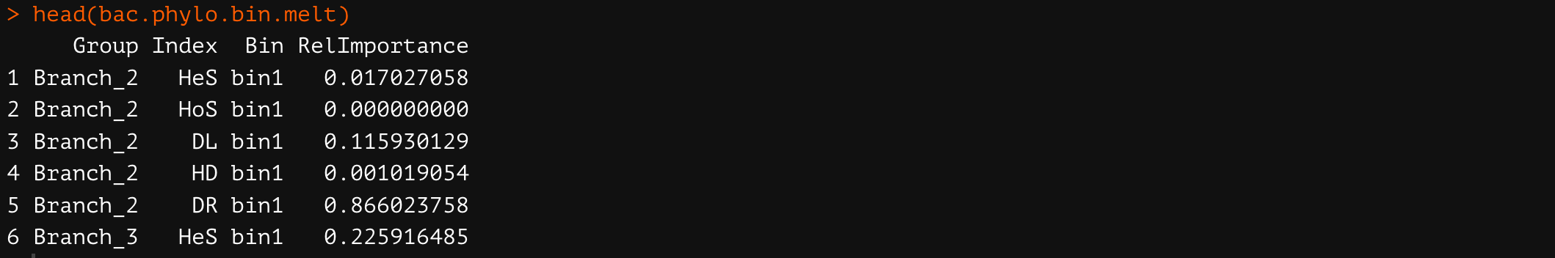
Visualization
13
Ecological drivers of treatment groups and each bin
2. Melt a data frame (make a long data frame object) (see 6-4-2)
bac.phylo.bin.melt <- reshape2::melt(bac.phylo.bin)
subset(bac.phylo.bin.melt, value == "NaN") # check if there is "NaN" among values
bac.phylo.bin.melt<-subset(bac.phylo.bin.melt, value != "NaN") # remove "NaN" when it exists
names(bac.phylo.bin.melt)[3] <- "Bin"
names(bac.phylo.bin.melt)[4] <- "RelImportance"
head(bac.phylo.bin.melt)

Slide 39
Visualization
14
Ecological drivers of treatment groups and each bin
2. Melt a data frame (make a long data frame object) (see 6-3-2)
### Arrange the values prior to plotting
bac.phylo.bin.melt$Bin <- factor(bac.phylo.bin.melt$Bin, levels = c("bin1","bin2","bin3","bin4","bin5"))
bac.phylo.bin.melt$Index <- factor(bac.phylo.bin.melt$Index, levels = rev(c("HoS","HeS","DL","HD","DR")))
bac.phylo.bin.melt$Group <- factor(bac.phylo.bin.melt$Group, levels = group.list)

Slide 40
Visualization
15
Ecological drivers of treatment groups
3. Make a plot (see 6-3-3)
ggplot(bac.phylo.bin.melt, aes(x=Bin, y = RelImportance, fill = Index)) +
geom_bar(stat="identity", width = 0.8, position = 'stack') +
facet_wrap(~Group, nrow =2)+
scale_fill_manual(values = c("HoS"= "#3c93c2","HeS" = "#9ec9e2", "DL" = "#fcde9c", "HD" = "#feb24c",
"DR"="#fc4e2a")) +
xlab('')+ theme(aspect.ratio = 1) +
ylab("Relative importance \n") +
guides(fill = guide_legend(nrow = 5,reverse = F))+
theme(legend.position="right") +
theme(plot.title = element_text(size = 20,hjust = 0.5, face='bold')) +
theme(axis.title.x = element_text(size = 15,hjust = 0.5, face='bold')) +
theme(axis.title.y = element_text(size = 13,hjust = 0.5, face='bold')) +
theme(axis.text.x = element_text(angle = 90, hjust = 0.5, vjust=0.4,size=12, face='bold',color='black'))+
theme(axis.text.y = element_text(size=15, face='bold',color='black'))+
scale_y_continuous(breaks=seq(0,1,0.2))+
theme(panel.grid.major = element_blank()) +
theme(panel.grid.minor = element_blank(), panel.background=element_blank(),panel.border=element_blank(), plot.background=element_blank())

Slide 41
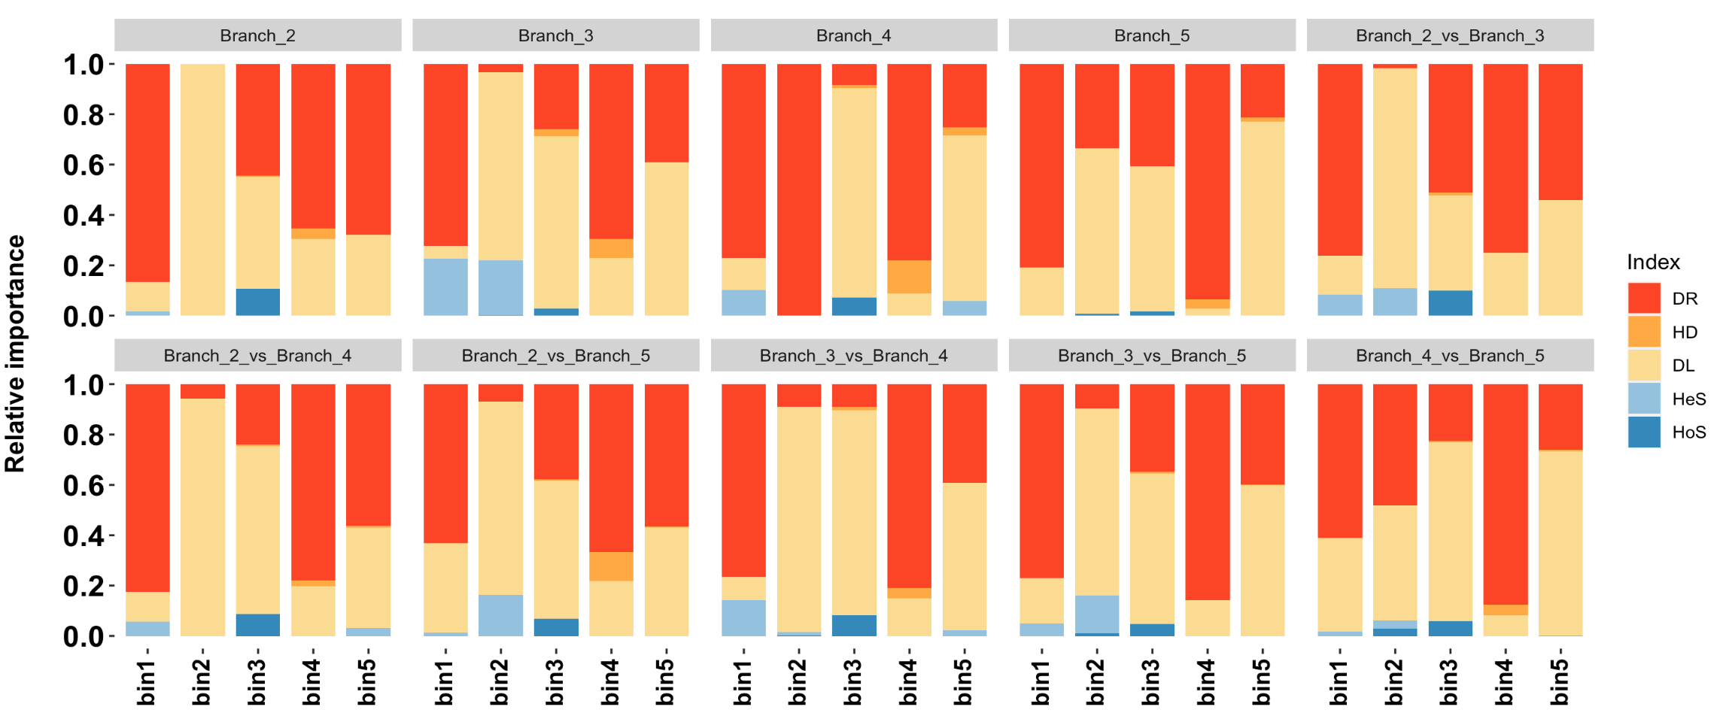
Further application
16

Slide 42
Analysis
17
(Optional) Run the iCAMP analysis with normalized ASV or OTU abundances (see 4-3)
In general, normalized or transformed ASV or OTU abundances are used for the microbiome analyses.
comra=comm/rowSums(comm)
taxo.metric='bray'
transform.method='hellinger'
prefixtran=paste0(prefix,"hell")
omit.option = "no"
bin.size.limit = 5 icres <- iCAMP::icamp.big(comm=comm,tree=tree,pd.desc=pd.big$pd.file, pd.spname=pd.big$tip.label, pd.wd=pd.big$pd.wd,
rand=rand.time,prefix=prefixtran,ds=0.2,pd.cut=NA,sp.check=TRUE,
phylo.rand.scale="within.bin",taxa.rand.scale="across.all",
phylo.metric="bMPD",sig.index="Confidence", bin.size.limit=bin.size.limit,nworker=nworker,memory.G=memory.G,
rtree.save=FALSE,detail.save=TRUE,qp.save=FALSE,detail.null=FALSE, ignore.zero=TRUE,output.wd=save.wd,correct.special=TRUE, unit.sum=rowSums(comra), special.method="depend",ses.cut = 1.96, rc.cut = 0.95,conf.cut=0.975, omit.option="no",meta.ab=NULL, taxo.metric=taxo.metric, transform.method=transform.method,
logbase=2, dirichlet=FALSE)

Slide 43
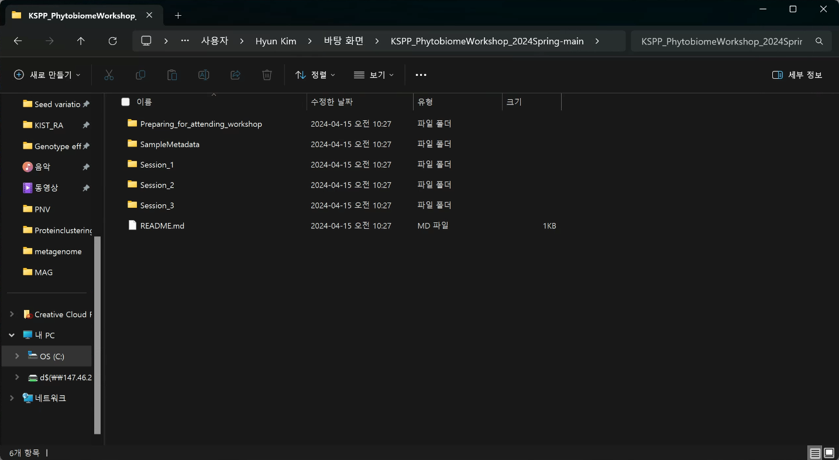
How to add a path in the R code
17
1. Open the working directory.

Slide 44
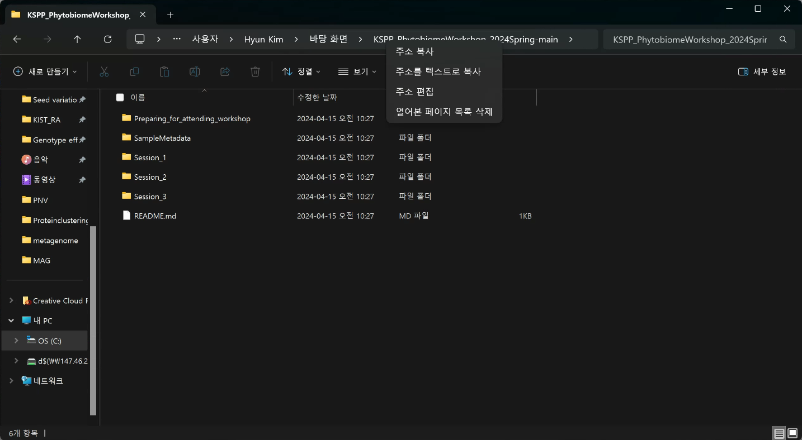
How to add a path in the R code
17
2. Move your cursor to the address bar and right-click.

Slide 45
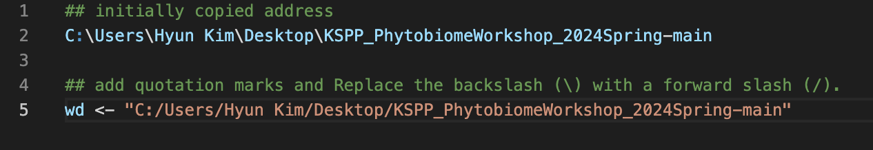
How to add a path in the R code
17
3. Click “Copy an address” and paste it into the R script. After that, add quotation marks and replace the backslash (\) with a forward slash (/).

